Slide 1
Vulnerability Report
Site: http://zero.webappsecuirty.com

Slide 2
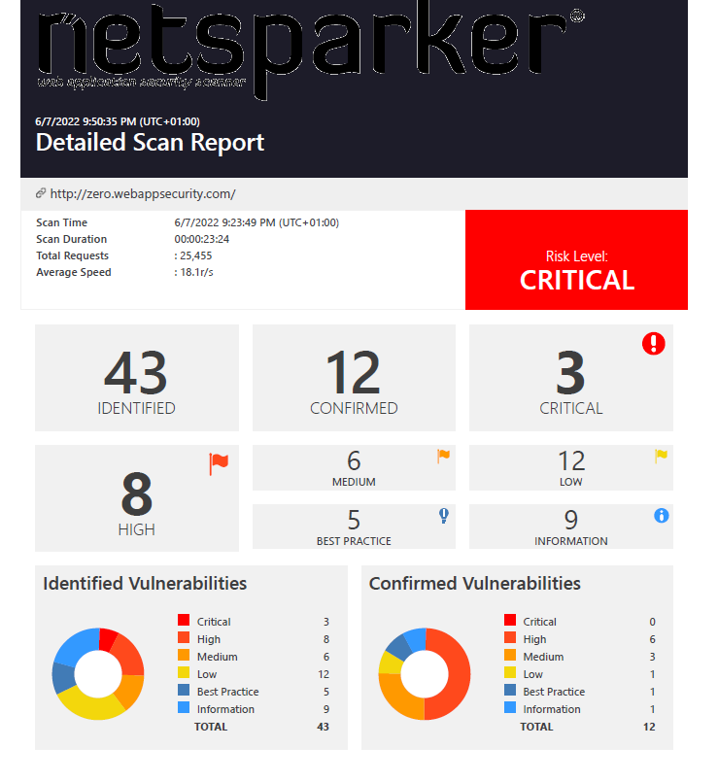
Result from Scanning:

Slide 3
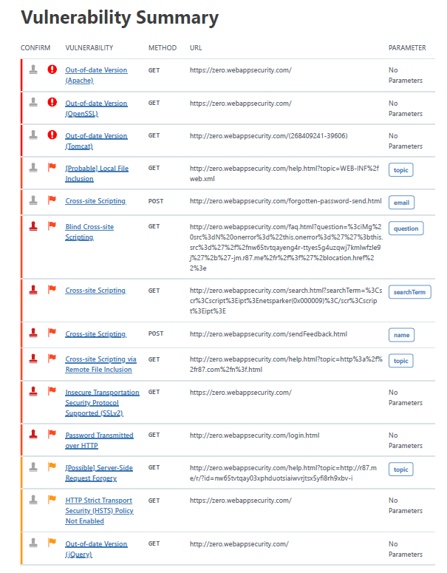
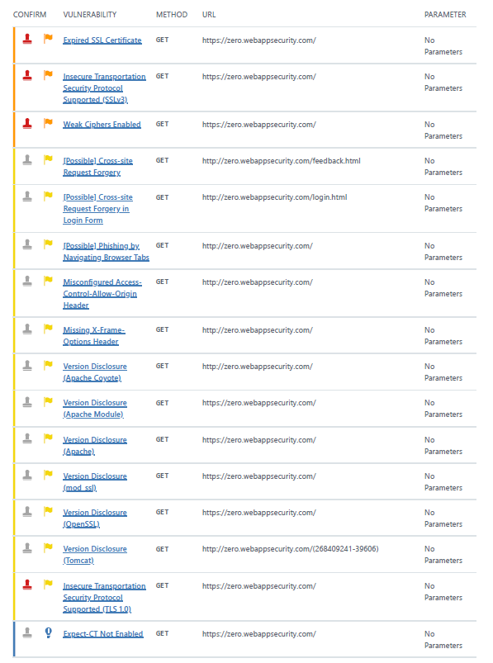

Slide 4
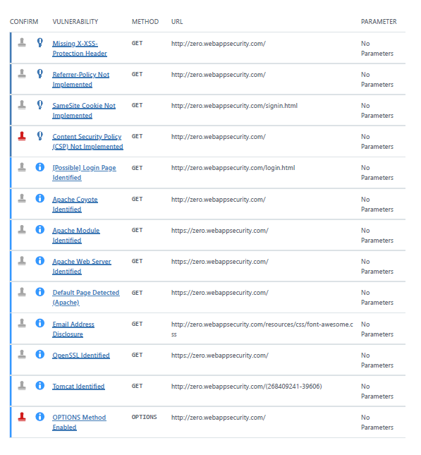

Slide 5
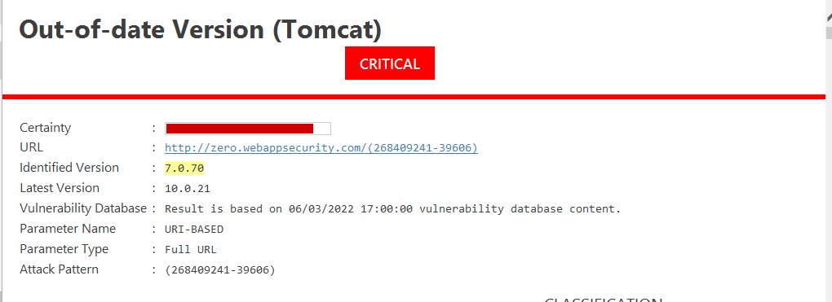
CRITICAL VULNERABILITIES FOUND:
During the scanning phase of http://zero.webappsecurity.com/ three critical vulnerabilities were found:
Out of Date Version (Apache) – version 2.2.6
Out of Date Version (OpenSSL)- version 0.9.8e
Out of Date Version (Tomcat)- version 7.0.70

Slide 6
Critical vulnerability found: Out-of-date version of Tomcat
Impact: Old version of software, vulnerable to many different types of attacks.

Slide 7
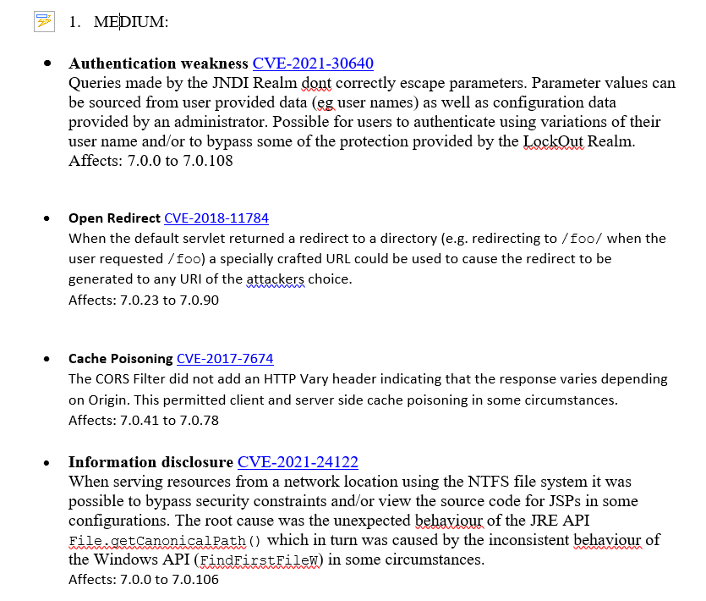
Severity of VulnerabilitiesBased on National Vulnerability Database:

Slide 8
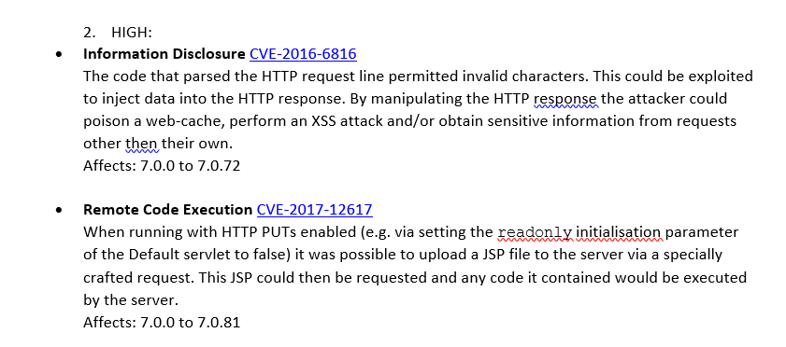
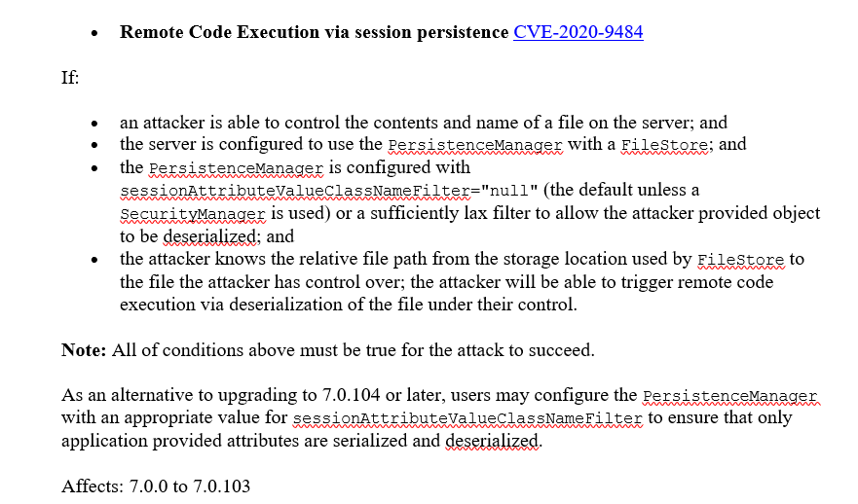

Slide 9
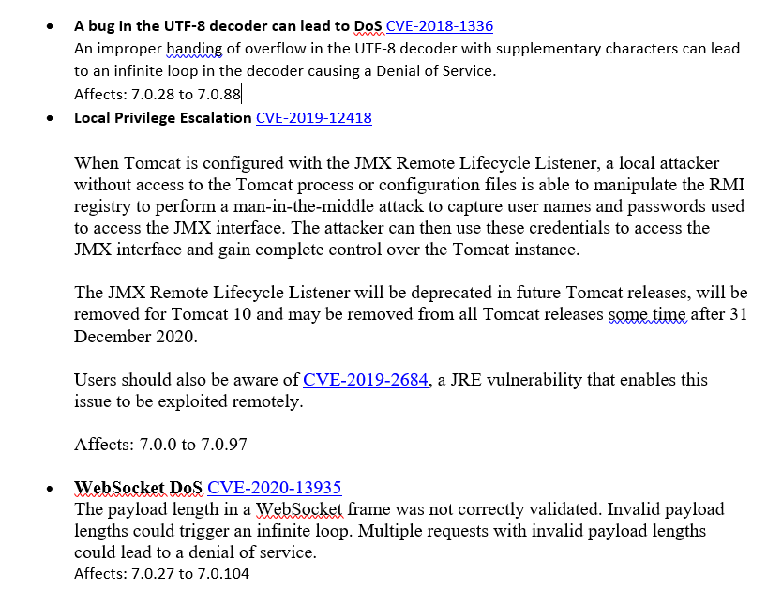

Slide 10
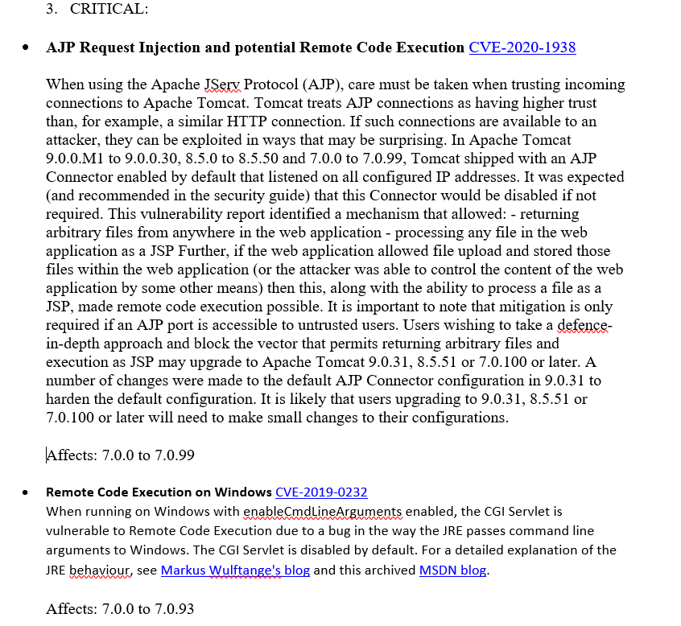

Slide 11
